Slide 1
Cybersecurity Concepts
Muhammad Waseem

Slide 2
Agenda
What is cybersecurity?
Why is it important?
Key concepts: CIA triad, risk management, threat modeling, defense-in-depth

Slide 3
CIA Triad
Confidentiality: Keeping secrets safe
Example: Locking your diary to prevent others from reading your private thoughts

Slide 4
CIA Triad (cont.)
Integrity: Making sure things are accurate and reliable
Example: Checking your homework answers twice to make sure they're correct

Slide 5

CIA Triad (cont.)
Availability: Making sure things are always there when you need them
Example: Keeping your phone charged so you can call your friends anytime

Slide 6

Risk Management
Finding and fixing problems before they cause trouble
Example: Checking weather forecasts to decide whether to carry an umbrella

Slide 7

Threat Modeling
Thinking about ways bad things could happen and planning to stop them
Example: Looking both ways before crossing the street to avoid accidents

Slide 8
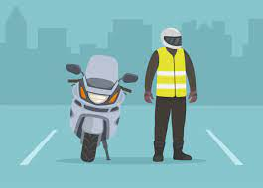
Defense-in-Depth Strategies
Using many layers of protection to stay safe
Example: Wearing a helmet, knee pads, and elbow pads when riding a bike

Slide 9
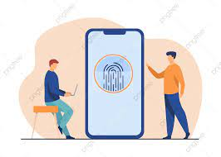
Defense-in-Depth Strategies (cont.)
Example (continued): Putting a password on your phone and using a fingerprint scanner for extra security

Slide 10
Authentication vs Authorization
Authentication: Making sure you are who you say you are.
Example: Entering your username and password to access your email account.
Authorization: Deciding what you can and cannot do once you've proven who you are.
Example: Being allowed to view but not edit certain files on a shared drive.

Slide 11
Authentication Methods
Passwords: Secret codes known only to you.
Example: Logging into your smartphone with a PIN or pattern.
Biometrics: Using unique physical features for identification.
Example: Unlocking your device with your fingerprint or face scan.

Slide 12
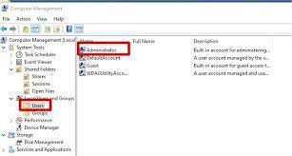
Authorization Mechanisms
Access Control Lists (ACL): Lists that say who can access what.
Example: Only allowing certain users to open specific folders on a computer.

Slide 13
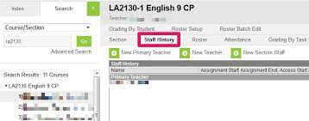
Authorization Mechanisms
Role-Based Access Control (RBAC): Giving permissions based on your job or role.
Example: Giving teachers access to grade books, but not students.

Slide 14
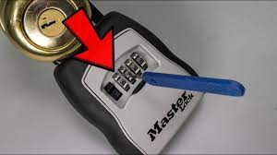
Encryption Basics
Encryption: Turning messages into secret codes.
Example: Locking a box with a key only you and the receiver have.

Slide 15

Decryption
Decryption: Turning secret codes back into messages.
Example: Unlocking the box with the key to read the message inside.

Slide 16
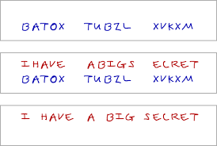
Symmetric Encryption
Symmetric Key Encryption: Using the same key to lock and unlock.
Example: Sharing a secret code with a friend to encrypt and decrypt messages.
Advantages: Fast and simple for everyday use.

Slide 17
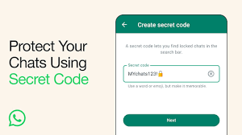
Asymmetric Encryption
Asymmetric Key Encryption: Using two different keys for locking and unlocking.
Example: Giving out a special lock for others to send you secret messages, but only you have the key to unlock them.
Advantages: Safer because you don’t have to share your secret key with everyone.

Slide 18
Malware
Malware: Malicious software designed to harm or exploit computers or networks.
Types:
Viruses: Programs that replicate and spread by attaching themselves to other files or programs.
Worms: Self-replicating malware that spreads across networks without human intervention.
Ransomware: Malware that encrypts files or locks computer systems, demanding a ransom for their release.

Slide 19

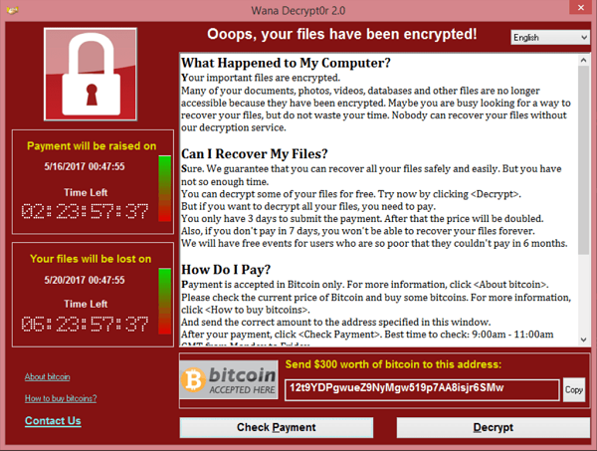
Examples:
Virus: Melissa virus, ILOVEYOU virus
Worm: Conficker, WannaCry
Ransomware: CryptoLocker, WannaCry (again)

Slide 20
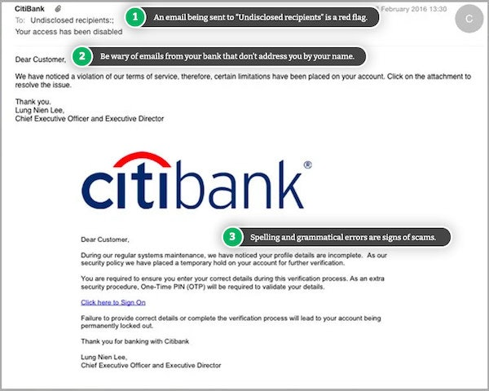
Phishing
Phishing: Fraudulent attempts to trick individuals into revealing sensitive information.
or performing actions.
Examples:
Phishing: Fake emails pretending to be from banks, asking for login credentials.

Slide 21
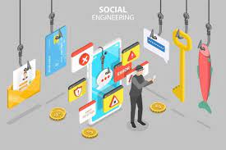
Social Engineering
Social Engineering: Manipulating people into divulging confidential information
Social Engineering: Pretending to be an IT technician and convincing someone to share their password.

Slide 22
Denial-of-Service (DoS) Attacks
Denial-of-Service (DoS): Overloading a system or network to disrupt its normal functioning.
Distributed Denial-of-Service (DDoS): Coordinated DoS attacks using multiple compromised systems.

Slide 23
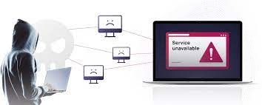
Example
DoS: Flooding a website with excessive traffic to make it unavailable to legitimate users.

Slide 24
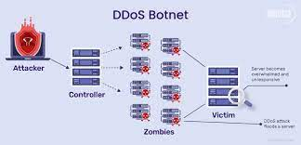
example
DDoS: Using a botnet to bombard a server with traffic from thousands of infected computers.

Slide 25
Impact of Malware and Cyber Attacks
Data Loss: Theft or destruction of sensitive information.
Financial Loss: Costs associated with remediation, downtime, and potential extortion.
Reputation Damage: Loss of trust and credibility among customers and stakeholders.
Legal Consequences: Fines and legal actions for non-compliance with data protection laws.

Slide 26
Defense Mechanisms Against Cyber Attacks
Antivirus Software: Detects and removes malware from systems.
Firewalls: Filters network traffic to block malicious connections.
Security Awareness Training: Educates users about common threats and how to avoid them.
Regular Software Updates: Patches vulnerabilities to prevent exploitation by attackers.

Slide 27
Understanding Network Architecture and Protocols

Slide 28
Network Architecture:
OSI Model: A conceptual framework used to understand network interactions in seven layers: Physical, Data Link, Network, Transport, Session, Presentation, and Application.
TCP/IP Model: A simplified model used in practice, consisting of four layers: Network Interface, Internet, Transport, and Application.

Slide 29
Common Protocols:
HTTP/HTTPS: Protocols for web traffic.
FTP: File Transfer Protocol for transferring files.
SMTP: Simple Mail Transfer Protocol for email.
DNS: Domain Name System for translating domain names into IP addresses.
TCP/UDP: Transport layer protocols for reliable (TCP) and fast (UDP) data transmission

Slide 30
Common Network Vulnerabilities and Attacks

Slide 31
Vulnerabilities:
Unpatched Software: Software that lacks the latest security updates.
Weak Passwords: Easily guessable or default passwords.
Misconfigured Devices: Devices not properly configured for security.
Insufficient Encryption: Data transmitted without adequate encryption.

Slide 32
Attacks:
DDoS (Distributed Denial of Service): Overwhelms a network or service with excessive traffic, causing it to become unavailable.
Man-in-the-Middle (MitM): Intercepts and potentially alters communication between two parties without their knowledge.

Slide 33
Continue
Phishing: Deceptive attempts to obtain sensitive information by masquerading as a trustworthy entity.
SQL Injection: Insertion of malicious SQL queries into input fields to manipulate databases.
Cross-Site Scripting (XSS): Injection of malicious scripts into web pages viewed by other users.

Slide 34
Network Defense Mechanisms

Slide 35
Firewalls:
Function: Monitors and controls incoming and outgoing network traffic based on predetermined security rules.
Types:
Packet-filtering Firewalls: Inspect packets and block those that do not match predefined rules.
Stateful Inspection Firewalls: Track the state of active connections and make decisions based on the context of the traffic.

Slide 36
Intrusion Detection Systems (IDS):
Function: Monitors network traffic for suspicious activity and known threats, alerting administrators when potential issues are detected.
Types:
Network-based IDS (NIDS): Monitors entire network traffic.
Host-based IDS (HIDS): Monitors individual hosts for suspicious activities.

Slide 37
Intrusion Prevention s Systems (IPS):
Function: Similar to IDS but actively blocks or prevents detected threats.
Types: Often integrated with firewalls to provide comprehensive security.

Slide 38
Web Security
SSL/TLS: Protocols for securing communication over a computer network.
Secure Coding Practices: Writing code with security in mind to prevent vulnerabilities.
Web Application Firewalls (WAF): Filters and monitors HTTP traffic between a web application and the
Internet.

Slide 39
Common Web Security Measures:
Input Validation: Ensuring data received from users is valid and safe.
Authentication and Authorization: Verifying user identities and granting appropriate access levels.
Regular Security Audits: Periodic reviews of code and infrastructure to identify and address vulnerabilities.

Slide 40
Best Practices:
Regular Updates: Keeping all software and systems up-to-date with the latest security patches.
Data Encryption: Ensuring data is encrypted both at rest and in transit.
Strong Password Policies: Enforcing the use of complex and unique passwords.

Slide 41
Practical

Slide 42
Wireshark
A network protocol analyzer
Used for network troubleshooting, analysis, software and protocol development
Open-source and free to use

Slide 43
Installing Wireshark
Windows:
Download from the official website
Run the installer and follow the prompts
Install additional components like WinPcap/Npcap
Linux:
Use package manager (e.g., sudo apt-get install wireshark for Ubuntu)
Follow prompts to complete installation

Slide 44
What is nmap?
A network scanning tool
Used for network discovery and security auditing
Can detect open ports, running services, and operating systems

Slide 45
Continue
Perform a basic scan of your local network
nmap -sP 192.168.1.0/24
Scan a specific host for open ports: nmap -sT 192.168.1.1
Save the scan results to a file

